Slide 1
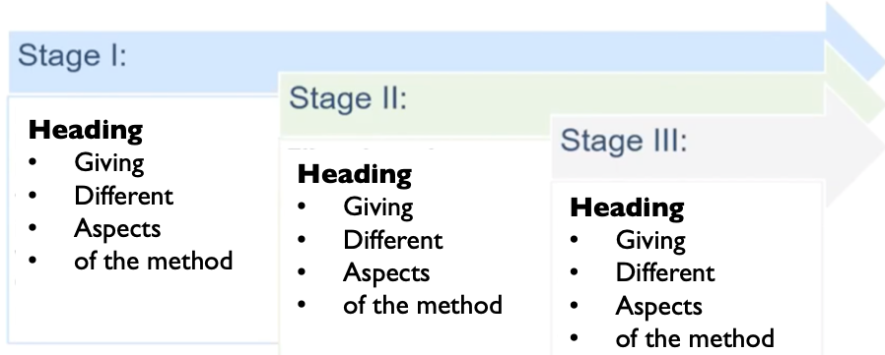
Here can be your logo or QR code
This could be the e-Poster title
EULAR Presentation number
This could be your sub-line – Authors, Co-Authors, Institution, etc.
This could be your Introduction
This could be your Results
This could be your Conclusions
Be brief and to the point.
Use the frame as a reference for the size of the introduction text.
Use the frame as a reference for the result text.
Use tables and figures that are:
Quick to read
Self explanatory
Easy on the eyes
Keep in mind consistent labelling.
Use colour to highlight important results or statistically significant values.
Use indentation for different levels of information (in tables).
text/table/figure block:
Font Size → There is no recommendation from us. You are free to decide. Our system caters for zooming in.
Use 3-column layout.
Figures and tables can span multiple columns.
Use the frame as a reference for the conclusions.
Conclusion section should be:
Readable
With a clear message
Linked to the aim of the study
Supported by the data
Can use larger font compared to other sections
Can use bullets
This could be your Objective
Use one or two sentences to state the primary and secondary (if available) objectives of the study.
Use the frame as a reference for the aims.
This could be your Tables or Figures or Images
This could be your Methods
Use the frame as a reference for the method text.
Consider methods in icon form or easy to grasp overviews, diagrams or schedules.
An example:
This could be your Tables or Figures or Images
GENERAL RECOMMENDATIONS:
Check grammar and spelling
Use bullets
Mainly headings, avoid massive text
Numbers in tables or figures, not in text
Images are preferred over text
This template is merely a guideline.
The sections can be moved or adjusted depending on what serves the study's overview best.
For more suggestions, tips and tricks please view the EULAR-EMEUNET poster presentation webinar.
This could be a place for your sources
Copyright © 2021 Author Names and Contact Details

